Slide 1
THE LANGUAGE OF FILM

Slide 2
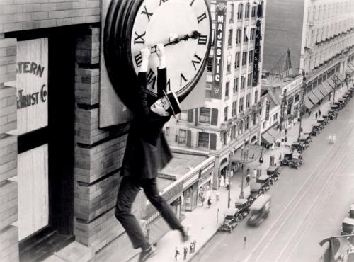
100 Years of Movies

Slide 3
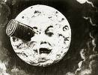
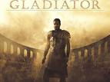
Film-a multi-medial narrative form based on a physical record of sounds and moving pictures; it is also a performed genre primarily designed to be shown in a public performance.

Slide 4
STRUCTURE
Refers to the audiovisual of a film and the particular tools and techniques used to create that design.
Camera
Lighting
Sound
Editing

Slide 5
CONTENT
From the script
Story
Character
Theme

Slide 6
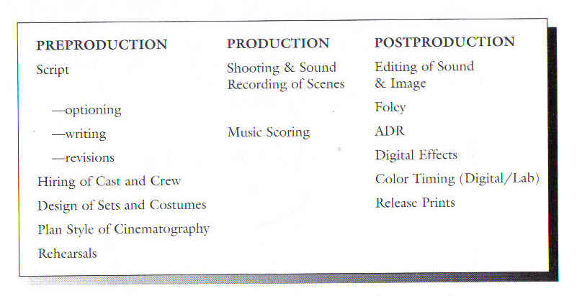
The Production Process

Slide 7
Production Process Techniques
Foley-additional sound recording for effects done during the post-production phase
ADR-dialogue replacement during the post-production phase

Slide 8
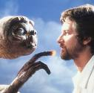
DIRECTOR (auteur)
The director has the chief artistic authority; coordinates and organizes the artistic inputs of other members of the production team.

Slide 9
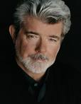
PRODUCER
Generally has administrative control over a production; the production stays on schedule and within budget). Sometimes engaged in artistic/creative decisions with director.

Slide 10
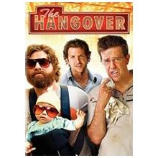
Time and Space
Running time-the duration of the film (most films are between 90 and 120 minutes in length)
The Hangover (2009) 100 minutes

Slide 11
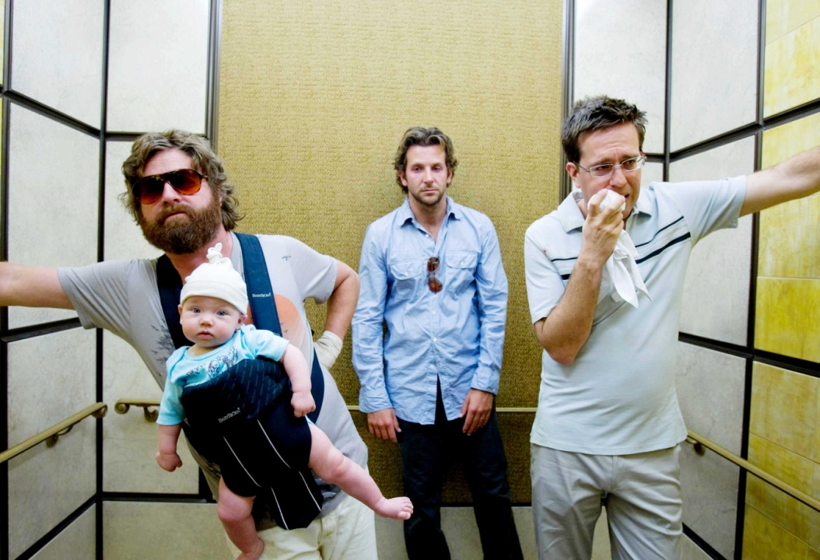
Time and Space
Story time-amount of time covered by the narrative, varies considerably film to film
The Hangover takes place over 48 hours

Slide 12
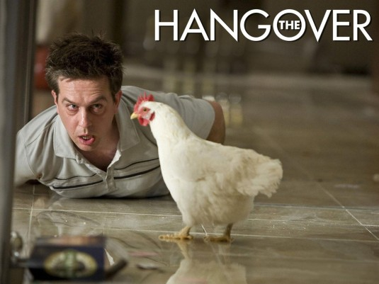
Time and Space
Internal structure time-structural manipulations of film form or technique through editing, lengths of shots, camera movements, etc.
The morning after scene is “slower” than some of the faster edited scenes. Why?

Slide 13
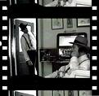
Frame-smallest unit on a film’s visual frame showing a single picture

Slide 14
Shot-sequence of frames filmed in a continuous take; interval on screen between edit points

Slide 15
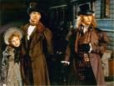
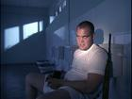
SCENE-sequence of shots, usually in a single time and place, often with the same characters

Slide 16
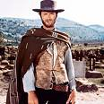
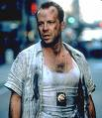
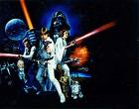
GENRES-Types of film recognized by audiences and/or producers, sometimes retrospectively.

Slide 17
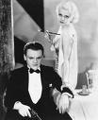
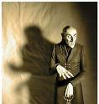
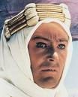
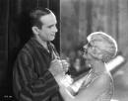
STORY / PLOT-the events that are directly presented in the film. The order, duration, and setting of those events, as well as the relation between them, all constitute elements of the plot.

Slide 18
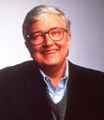
Film Reviewer
Film Reviewer-one who reviews films, several formats of reviews, criticisms and analyses (see attached worksheet)
Roger Ebert-one of the most famous film critics

Slide 19
THE OSCARS (Academy Awards)
Awards voted on and given by a board of film industry peers (The Academy of Arts and Sciences)
1st awards 1927
(Best Picture Wings)
What was this year’s Best Picture?
Although many other awards, this is the most prestigious award and film companies market many films according to the Oscars

